Slide 1
Serial number recognition
電機一 馮子軒
電機一 翁挺瑋

Slide 2
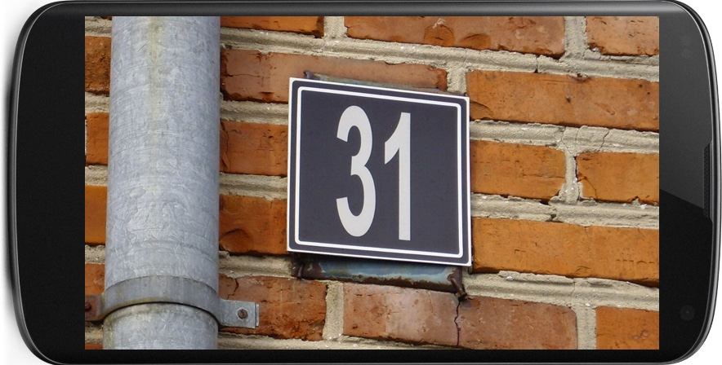
objective
31

Slide 3
DataSET
MNIST
Street View House Numbers (SVHN):
Dataset of house numbers in google view

Slide 4
Module
NumPy, SciPy
Keras, TensorFlow
OpenCV / SimpleCV

Slide 5
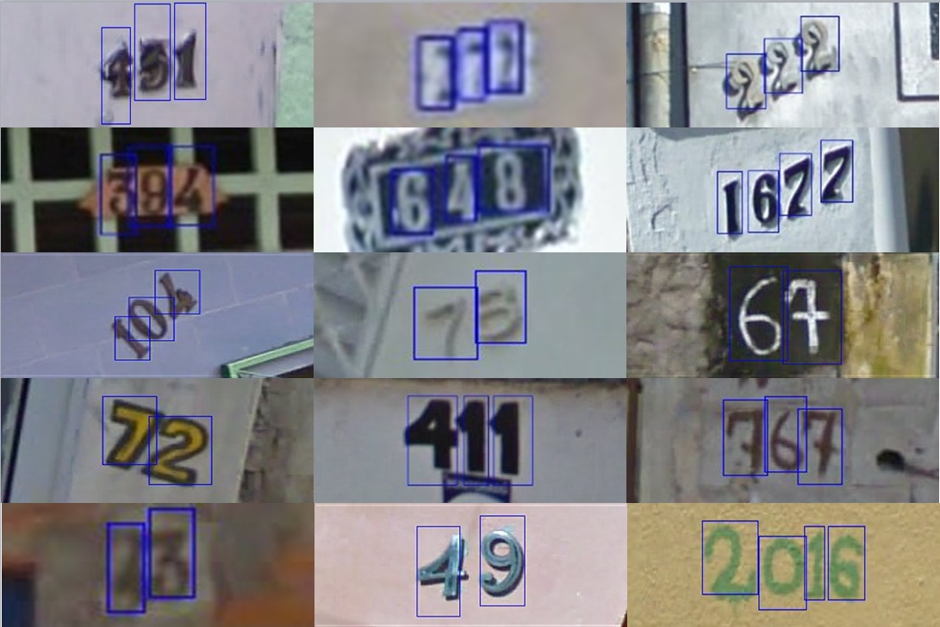
FeatureS of SVHN
SVHN dataset provides bounding boxes
Easy to track and tune for a localizer
32x32.mat

Slide 6
Step 1 : Digit
Design a neural network that can identify a single digit in an image.
Convolutional Neural Network
Pretrained layers
Using data from MNIST, notMNIST and 32x32.mat

Slide 7
Step 2 : Partition
Design a neural network that can partition a sequence of digits in an image.
Using the SVHN dataset

Slide 8
Step 3 : image processing
Design a neural network that can tune an image of digit properly.
Sharpening
Projecting

Slide 9
Step 4 : integration
Combine all layers and procedure
Test and Conclude

Slide 10
Resource
Course
Stanford CS231
Papers
Netzer, Y., et al. Reading Digits in Natural Images with Unsupervised Feature Learning. NIPS Workshop on Deep Learning and Unsupervised Feature Learning, 2011.
Goodfellow, I., et al. Multi-digit Number Recognition from Street View Imagery using Deep Convolutional Neural Networks. ICLR, 2014.

